Slide 1
Object Tracking for Robotic Arm using Depth Image Processing

Slide 2
Kinect Sensor
Encodes every pixel of an image as RGB + D(depth) information
It comprises of an RGB camera and an infrared sensor for depth calculation
It helps in finding 3D pose of objects

Slide 3
Gaussian Blur
It is the blurring of an image by a Gaussian function.
Used to reduce image noise and reduce detail
Since the Fourier transform of a Gaussian is another Gaussian, applying a Gaussian blur has the effect of reducing the image's high-frequency components; a Gaussian blur is thus a low pass filter.

Slide 4
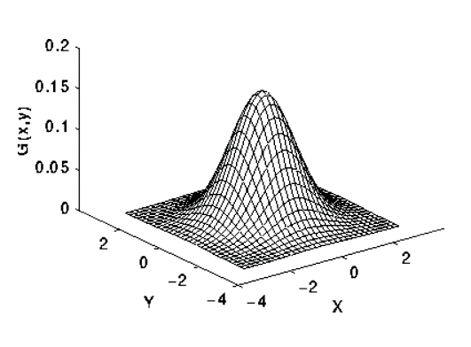
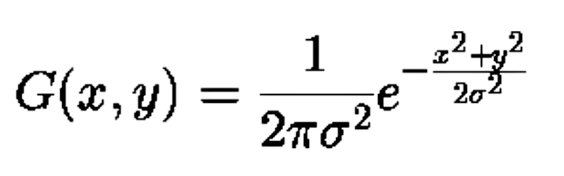
2-D Gaussian Distribution with mean (0,0) and standard deviation = 1

Slide 5
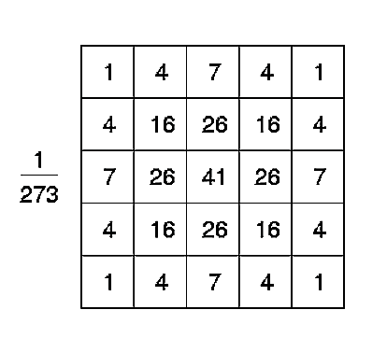
A Discrete Approximation of The Gaussian Function
We convolve an image with this filter to perform smoothening on the image

Slide 6
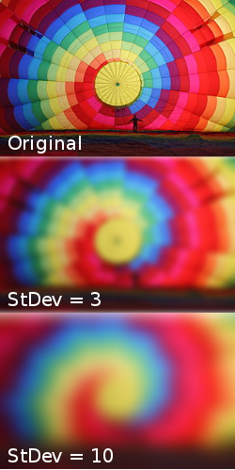
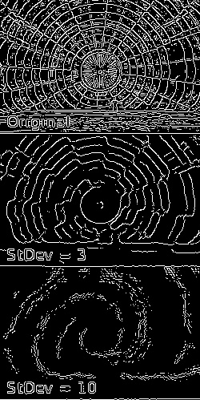

Slide 7
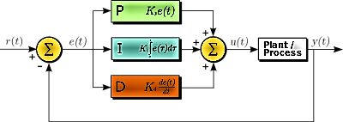
PID Controller
Used to minimize error

Slide 8
Butterworth Low Pass Filter
This LPF lets signals with the frequency lesser than 20 rad/sec pass and attenuates signals with frequency higher than this threshold
Helps to stabilize the Robotic Arm by removing unwanted frequency components (noise) from PID output
It removes short term fluctuations and enhances long term trends

Slide 9
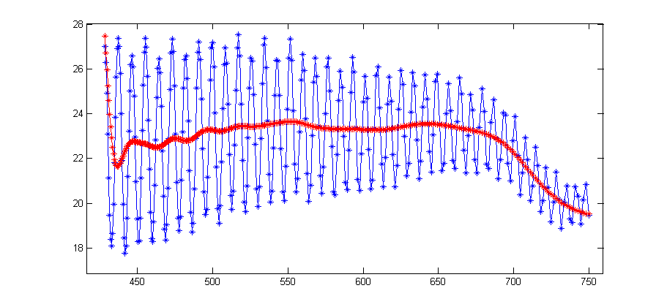
Smoothened Waveform from Butterworth Filter

Slide 10
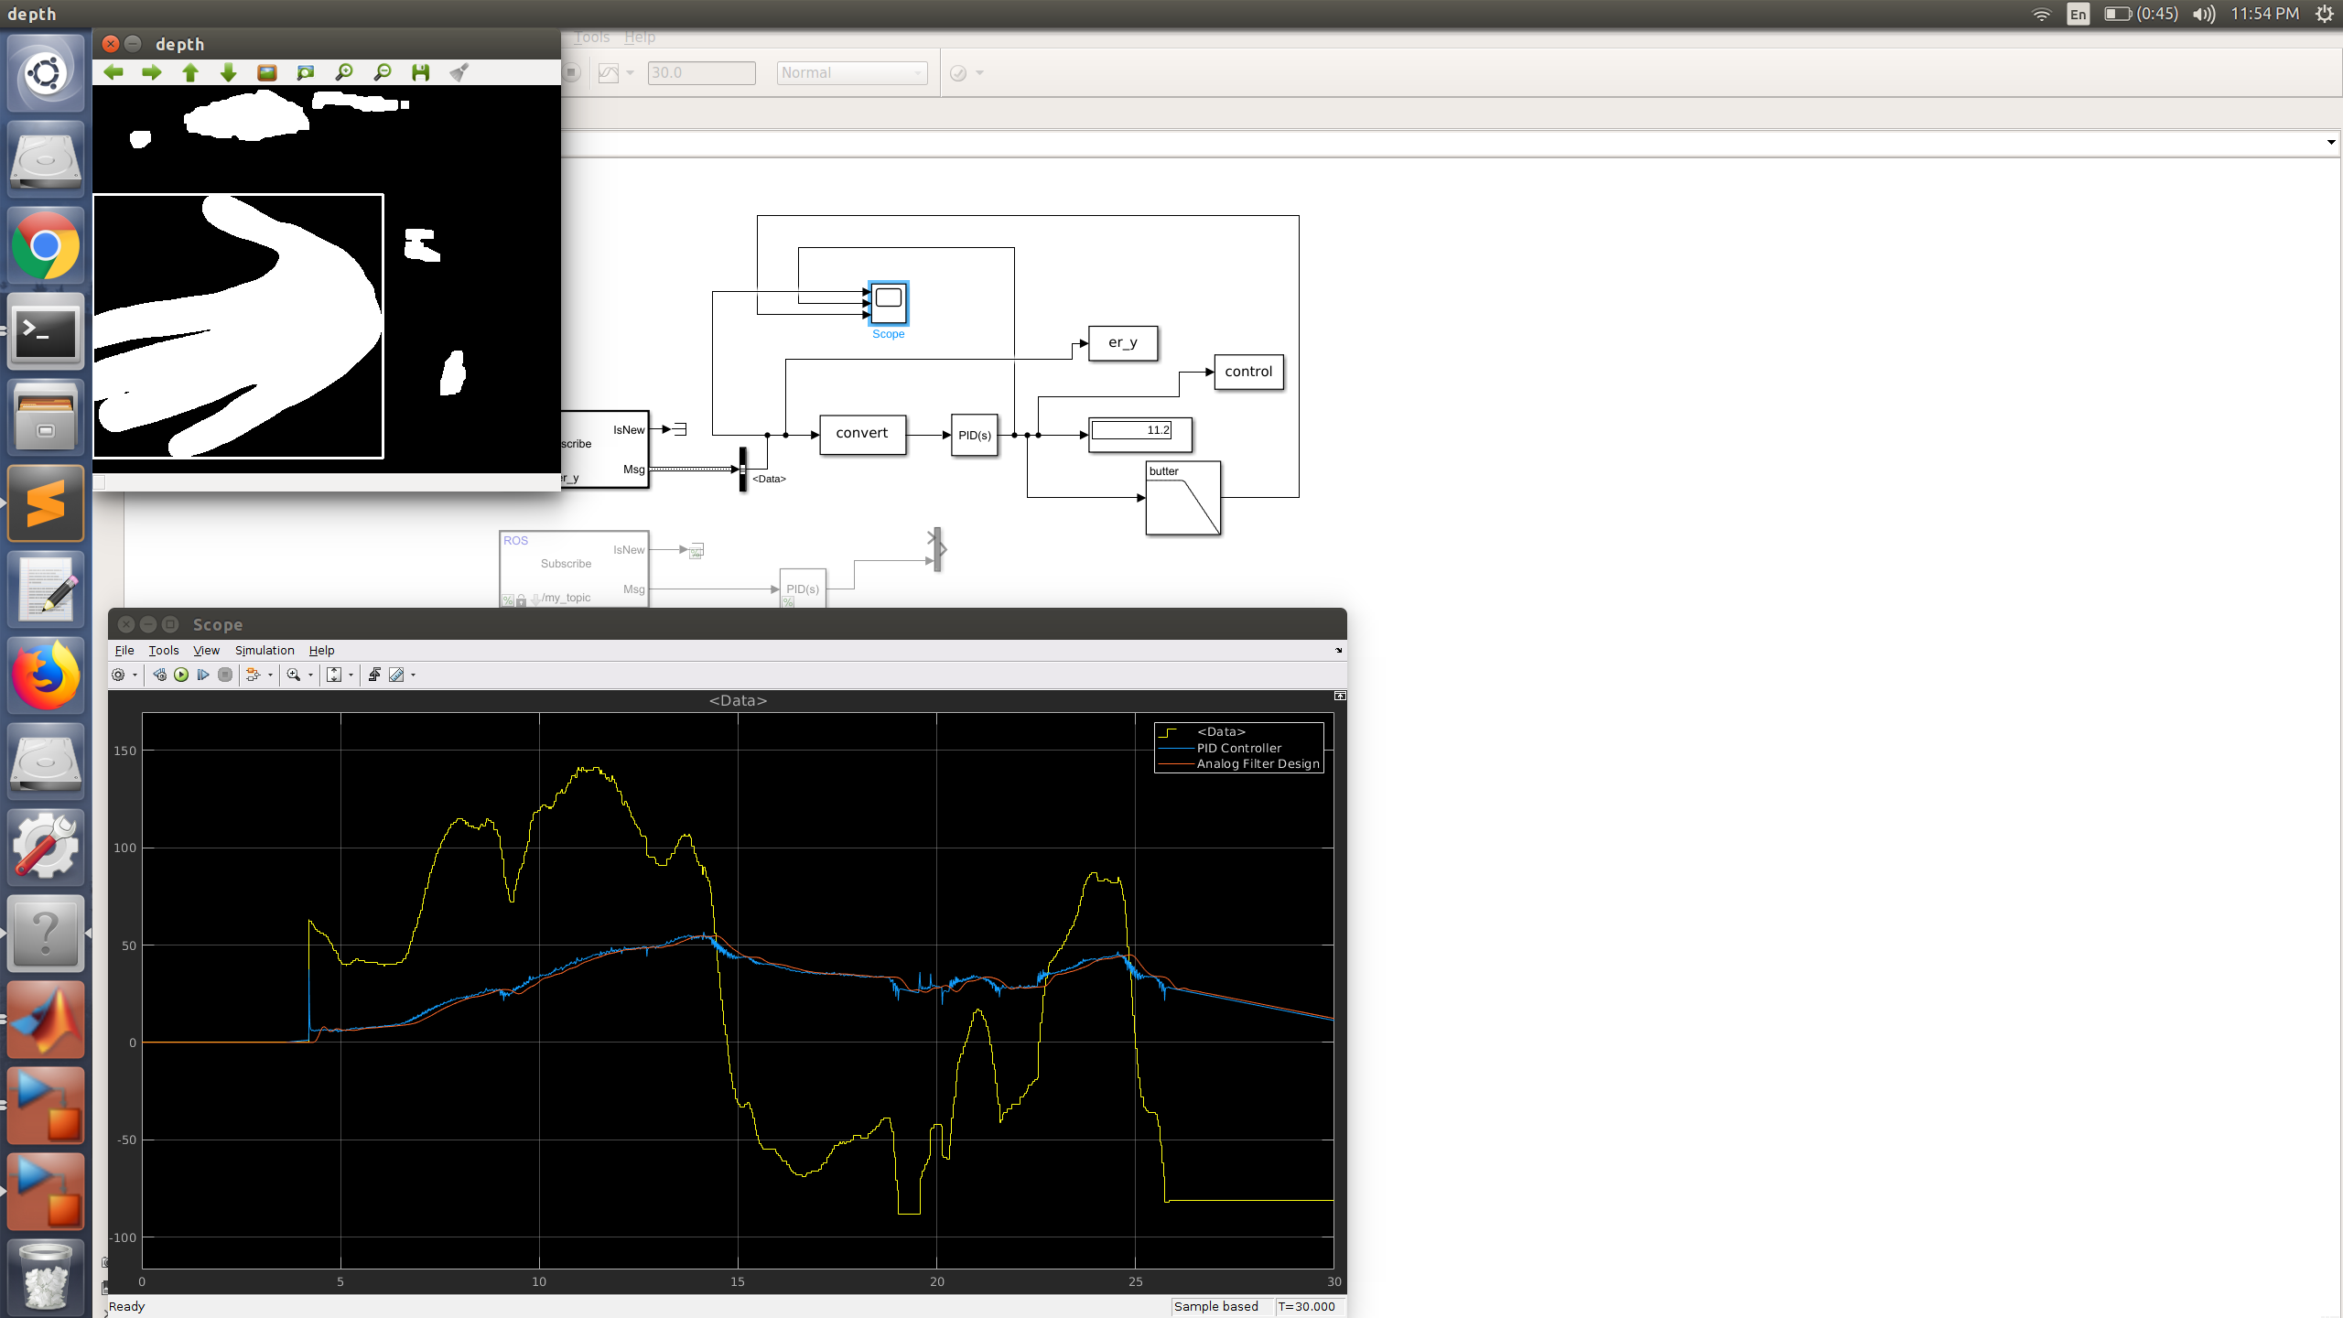
Object Detection

Slide 11
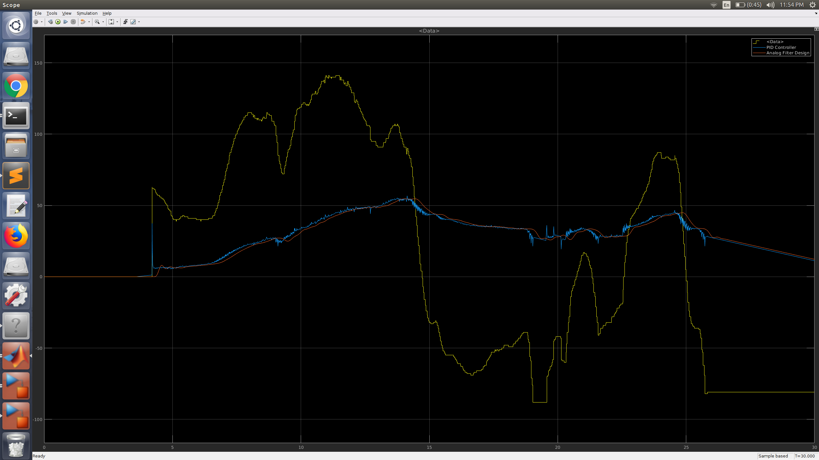
Processed and Unprocessed Waveforms

Slide 12
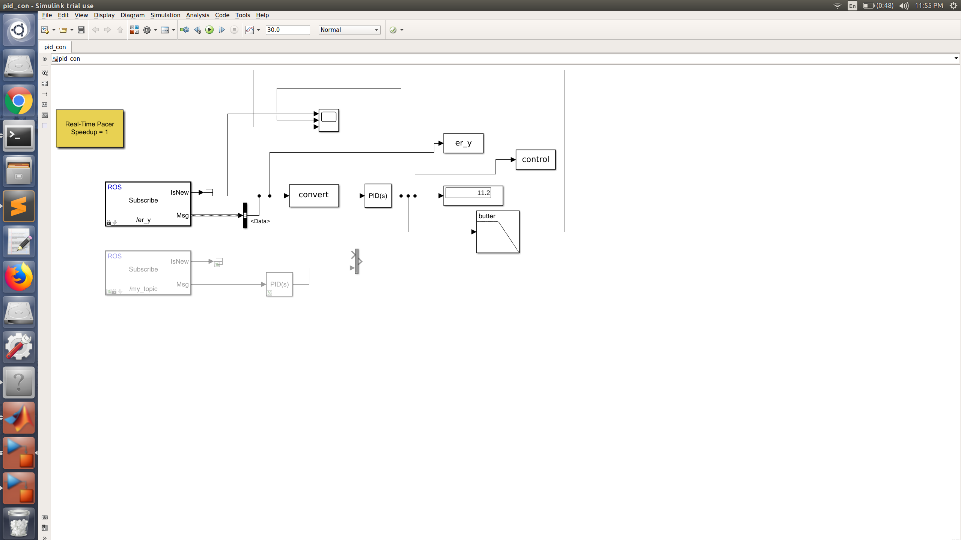
Simulink Block

